Slide 1
Social Media Posts
Zolvix / worm campaign
Illustrations of posts for customers to use
(all images provided as jpegs for customers to use and text provided for them to copy and paste into their social platforms)
PM-UK-20-0409

Slide 2
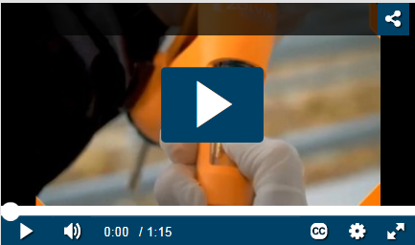
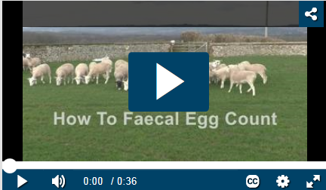
How To Videos….
Calibrating any drench applicator is important before dosing. Watch this 1.15min video on calibration and administration of Zolvix. Watch the video here: www.farmanimalhealth.co.uk/sheep/sheep-worms/optiline-drencher
Unsure about how to take a Faecal Egg Count (FEC)? Watch the 36 second video here. www.farmanimalhealth.co.uk/sheep/sheep-worms/faecal-egg-counts
PM-UK-20-0409

Slide 3
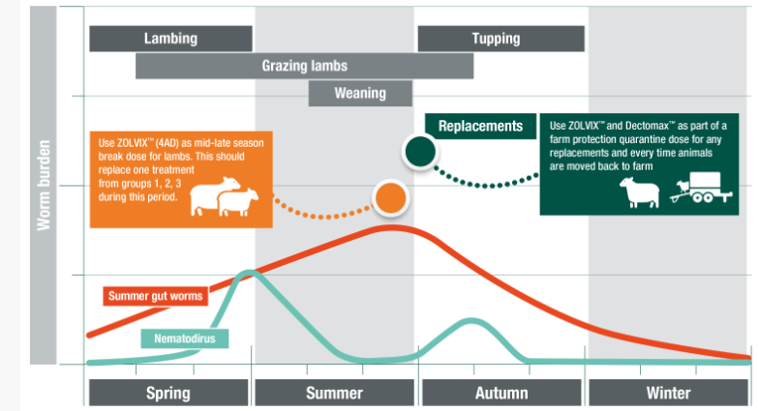
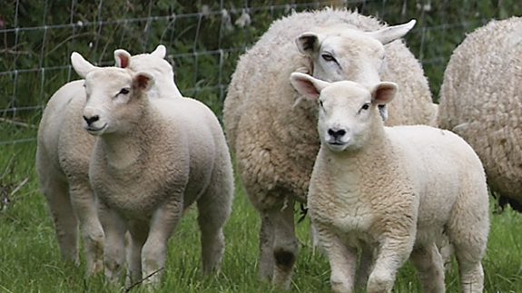
Worm wisdoms….
Worm Wisdoms: Understand the worm challenge through the year.
Ask your vet or animal health advisor or click here to find out more https://farmanimalhealth.co.uk/sheep/sheep-worms
Worm Wisdoms: Sheep develop immunity against the major worms in the UK at around one year of age and can then normally withstand a roundworm infection without the need for treatment. Ask your vet or animal health advisor for more information or visit https://farmanimalhealth.co.uk/sheep/sheep-worms
PM-UK-20-0409

Slide 4
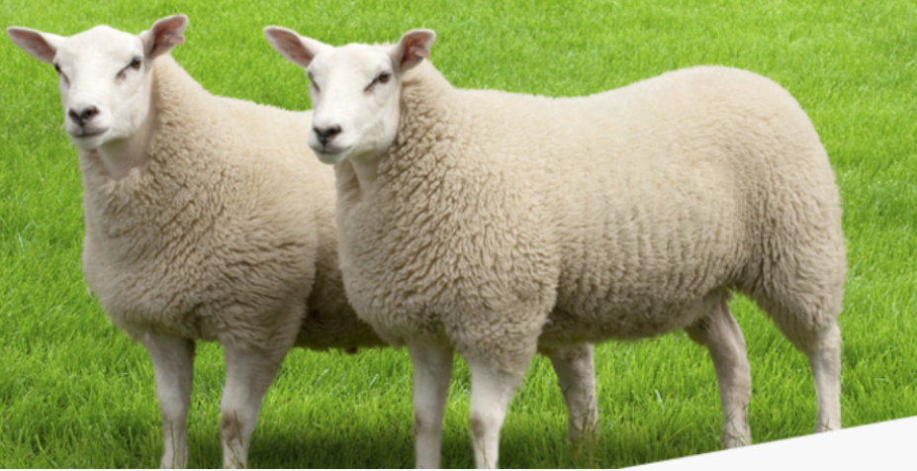
Mid-late season….
Are you realising your lambs’ growth potential?
Resistant worms that have survived earlier treatments risk limiting performance. For productivity now and in the future, ask in store today to plan your lamb break dose. Find out more www.farmanimalhealth.co.uk/sheep/sheep-worms/zolvix-break-dose
What are the long term benefits of a mid-late season break dose for your lambs?
By removing the worms left behind, the number of resistant eggs reaching the pasture in the autumn are minimised. Find out more www.farmanimalhealth.co.uk/sheep/sheep-worms/zolvix-break-dose
PM-UK-20-0409

Slide 5
Mid-late season….
Worm wisdoms. Managing the gut round worm burden in lambs is essential if lambs are to grow well. Find out more about www.farmanimalhealth.co.uk/sheep/sheep-worms/zolvix-break-dose
Clearing out leftover worms with a mid-late season break dose will allow lambs to hit their growth potential as well as helping to slow the development of resistance to the older three groups of wormers. Find out more www.farmanimalhealth.co.uk/sheep/sheep-worms/zolvix-break-dose
PM-UK-20-0409

Slide 6
Mid-late season….
Worm wisdoms. Resistant worms that have survived earlier treatments risk limiting lamb performance. For productivity now and in the future, ask your animal health advisor about Zolvix as a mid-late season break dose for your lambs. Find out more www.farmanimalhealth.co.uk/sheep/sheep-worms/zolvix-break-dose
Worm wisdoms. Wondering what the benefit of doing a mid-late season break dose for your lambs using the 4-AD (Zolvix) wormer? Ask your animal health advisor now or find out more at www.farmanimalhealth.co.uk/sheep/sheep-worms/zolvix-break-dose
PM-UK-20-0409

Slide 7
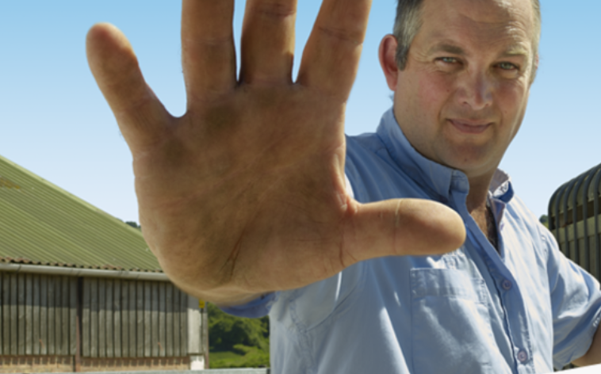
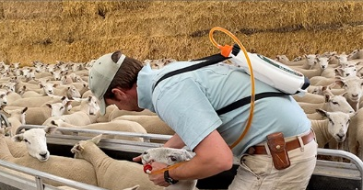
Farm protection….
Are you welcoming resistant worms to your farm?
New sheep potentially carry resistant worms, no matter how healthy they look. Protect your farm – plan your Zolvix dose for all incoming sheep.
Find out more https://farmanimalhealth.co.uk/sheep/sheep-worms/zolvix-quarantine-dose
Are you bringing sheep onto your farm?
Then remember to protect your farm and do a farm protection quarantine treatment including Zolvix (4AD) wormer.
Find out more https://farmanimalhealth.co.uk/sheep/sheep-worms/zolvix-quarantine-dose
PM-UK-20-0409

Slide 8
Farm protection….
Are you welcoming resistant worms to your farm?
Even the healthiest sheep can bring in resistant worms. Don’t take the risk – always do a farm protection (quarantine) treatment on any incoming sheep including Zolvix for worm control.
Find out more www.farmanimalhealth.co.uk/sheep/sheep-worms/zolvix-quarantine-dose
PM-UK-20-0409

Slide 9
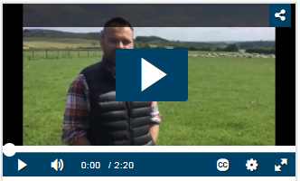
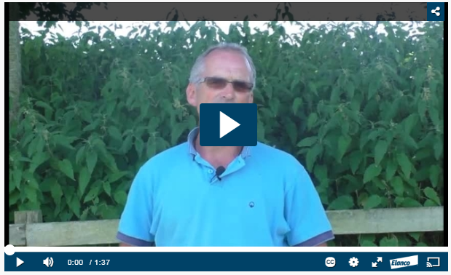
Testimonials…
Sheep farmer Simon says “Managing worm burden is essential for our pasture and flock. Following weaning we assess worm burdens. We dose with Zolvix on our farm for maximum worm kill.”
Watch farmer Simon’s story on managing worms on his flock
Sheep farmer Rob says “Keeping the flock in top condition is important to us – and results show that Zolvix clearly reduces worm burden. We believe its use is essential for the flock’s health, welfare and performance” Click here to watch farmer Rob’s story on managing his farm’s worm burden www.farmanimalhealth.co.uk/testimonial
PM-UK-20-0409

Slide 10
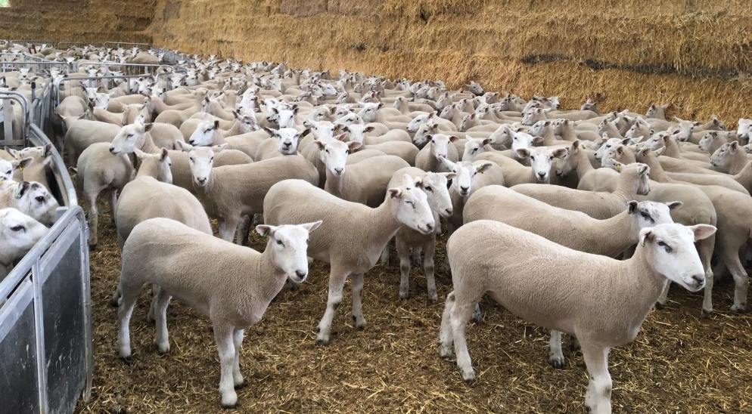
Testimonials…
Sheep farmer Robert says ““It’s all about taking charge before the problem, rather than trying to make a difference when it’s too late. ”
Watch farmer Robert’s story on managing worms on his flock
PM-UK-20-0409

Slide 11
General…
Checking dung samples from lambs can identify which parasite(s) might be causing a problem. Regular checks will also give advance warning of when worm numbers are getting high enough to slow down growth rates. Watch how to do a FEC here…
PM-UK-20-0409

